Slide 1
The Stirling Engine

Slide 2
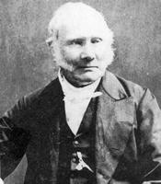
History
Reverend Dr. Robert Stirling (1790-1878)
Patented Stirling Engine in 1816
Invented air engine because steam engines would explode and harm workers.

Slide 3
How It Works
Works by heating and cooling a gas inside a sealed chamber.
Heating
Expansion
Cooling
Contraction

Slide 4
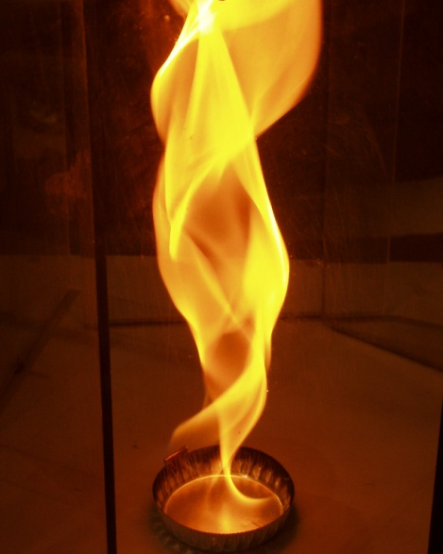
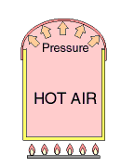
The Stirling Cycle
Heating
Expansion

Slide 5
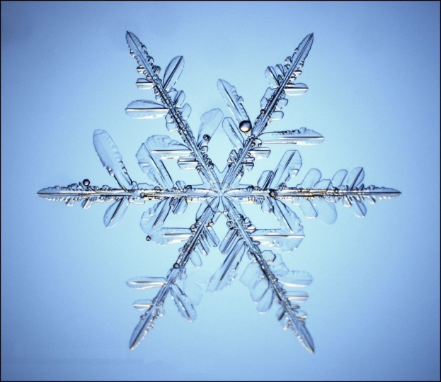
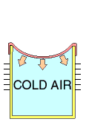
The Stirling Cycle
Cooling
Contraction

Slide 6
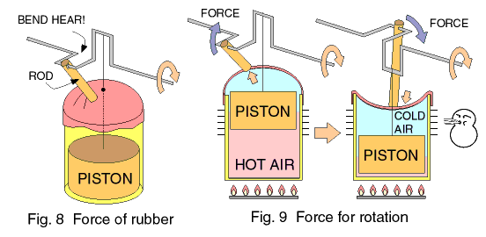
The Stirling Cycle Complete

Slide 7
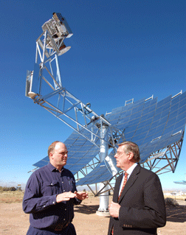
Current Applications
Solar to electric generation
Current record achieves 29.4% peak efficiency

Slide 8
Solar Dish Engines
Main advantage, adaptable to ANY heat source (fuel, gas, wood, coal, nuclear) anything that produces heat.

